Slide 1
Target Detection & Tracking

Slide 2
Project Supervisor :
Team Members :
Rohit Kamboj
IBM Trainer
DIT University
Dhiraj Kumar Saini 160110084
Ritam Ghosh 160111046
Rachit Goyal 160112002

Slide 3
Presentation Outline :
Introduction
Objective
Stages
Datasets
Model
Conclusion
Scope of Future Work

Slide 4
Introduction:
This project is to recognize and identify the moving objects for (specific) interest, and to track those moving objects throughout their life spans. This project aims for the existing challenging issue in the area of unsupervised surveillance and security. This project also aims to solve the issue that video feeds can’t be processes in real time and we cannot track the object in real time with accuracy. In this project deep neural network have been implemented to provide accuracy.
It can be widely use as object Detection, Object Tracking, Object Classification, object segmentation, In real time as defense and security surveillance, gamming and virtualization, medical diagnosis and sports, to classify, detect and track.

Slide 5
OBJECTIVE:
Our main aim is to detect the target objects and to track down it path through out its life span.
We made our project basically to detect and identify a tennis ball and then to tack it path down. It can be used in gamming and sports, to track and detect ball in real time game play.

Slide 6
Data Collection
Data Preprocessing
Model Defining
Model Testing
Model Training
Stages Of Implementation

Slide 7
DATASET
COLLECTION:
We collect images from google images manually.
PREPROCESSING:
We resized our images into 299x299 because
our model takes input size as 299x299

Slide 8
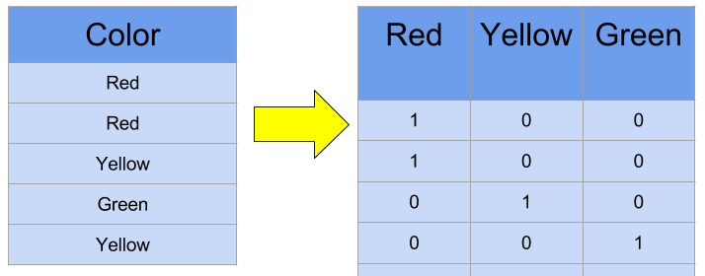
HOT ENCODING:
:
BATCH NORMALIZATION:
It mean gauss normalization. We normalize our data
so that All feature in the same range And contribute equally

Slide 9
MODEL
DEFINITION:
This approach is also used in the Inception-ResnetV2.This project
is implementation on the basis of Inception-ResnetV2. It is one
of the fastest algorithms present now. Google came up with new
approach and divide the model In modules. Google came up
with new approach and divide the model In modules.

Slide 10
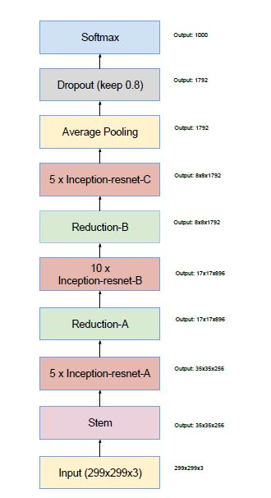
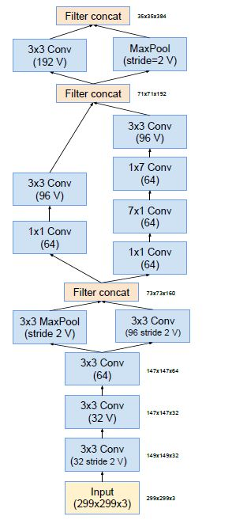
SCHEMA
STEM CELL

Slide 11
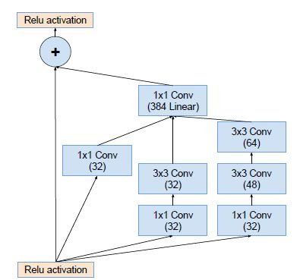
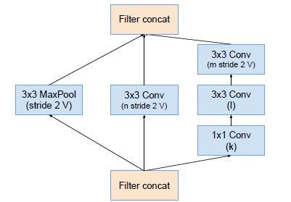
MODULE A
REDUCTION A

Slide 12
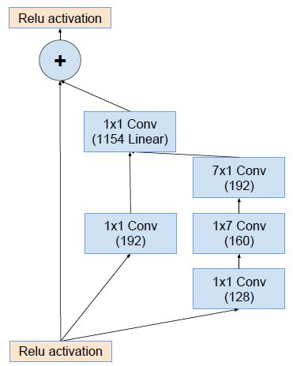
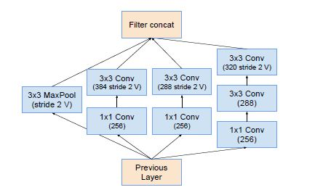
MODULE B
REDUCTION B

Slide 13
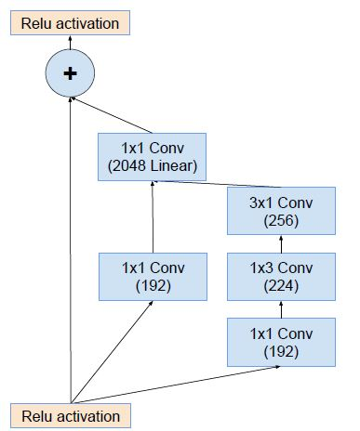
MODULE C

Slide 14
TRAINING:
EPOCHS: 25
BATCHES: 16
ACTIVATION: RELU ACTIVATION
OPTIMIZATION: Adam

Slide 15
MODEL SAVING
Our model is saved in Jason format.
Weight saved in H5 format.

Slide 16
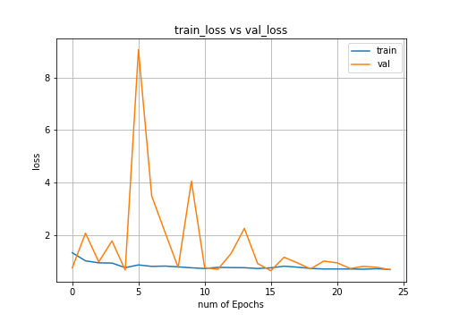
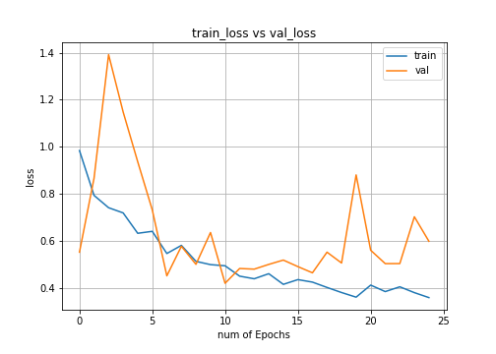
OVERFITTING:

Slide 17
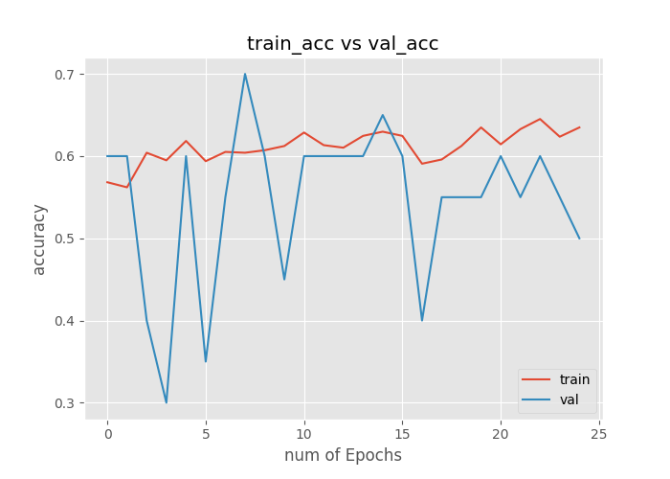
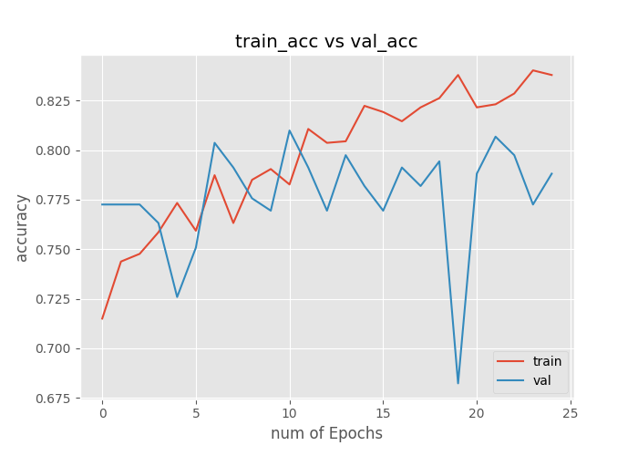

Slide 18
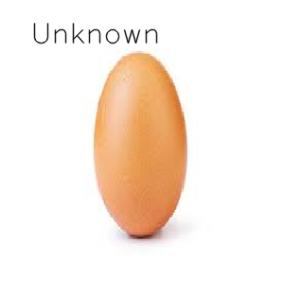
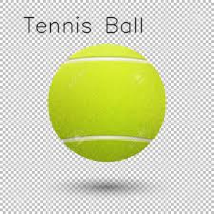
IMAGE PREDICTION:

Slide 19
CONCLUSION:
In this project, a ball detection and tracking algorithm is presented for
Object Detection, Object Tracking, Object Classification, Video
Surveillance, Background Modelling sequence. We have presented
our model based on research paper inception V4 and inception-resnet
that classify images and label videos based on the training it received it
has many application in field of medical diagnoses, defense, games
and virtualization and have high accuracy and high speed compare to
other model presented so far. For this project, we achieve with an
object-tracking program that can automatically track multiple objects.
It can also use to detect multiple object in wide range.

Slide 20
SCOPE OF FUTURE:
Processing time: Full search in the frame takes large amount of time.
We reduce searching time by searching only in some parts of the image.
We use motion to trigger the search and search only in the moving region,
However, this is still too slow for real time applications. Searching algorithm
such as Inception V4 and Inception resent version 2 algorithm might be
able to make this program faster because it reduce number of pixels
to be searched.
Motion Analysis: Another area that is very challenging. The segmented
moving object from tracking can be further analyzed with the statistics
of each motion to verify whether object is spreading or not.

Slide 21
Occlusion: We do not include occlusion in this program. If occlusion
occurs, tracking accuracy will be severely degraded. One way to fix it
to use the template data of a couple of last frames, and keep track
of the mean absolute difference or correlation in template matching.
If the difference increases (or the correlation decreases) dramatically
and abruptly, it suggests that occlusion already occurs. Then, the
program could wait until the occlusion passes, or use an old template
in a database instead of an occluded object.

Slide 22
Thankyou

